Slide 1
LTspice and SPICE Simulation

Slide 2
Simulation of Circuits
What is the Voltage at Vb?
SPICE is one of the alternatives to solving the problem by hand.
Notes:
(Hint: Vb == 15 V, The Circuit is symmetric about Vb)

Slide 3
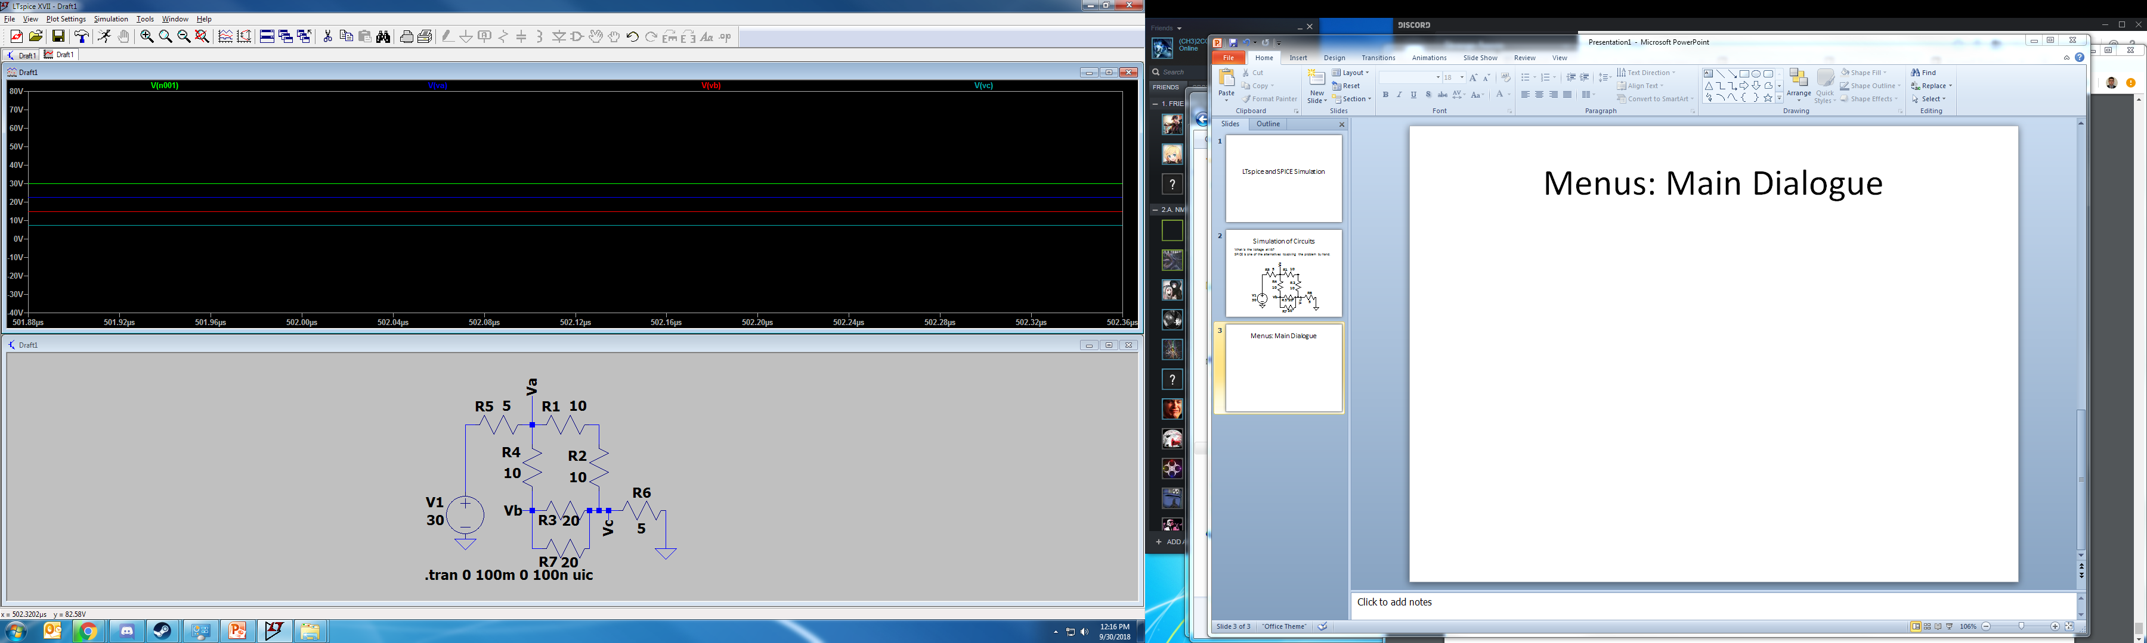
Menus: Left Side of Toolbar
Control Panel
HALT Simulation
Save (Ctrl+S)
RUN Simulation
New File (Ctrl+N)
Auto-Fit Graph
Zoom Function(s)

Slide 4
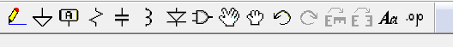
Menus: Right Side of Toolbar
Command (Hotkey)
Spice Directive (S)
Mirror (Ctrl+E)
Rotate (Ctrl+R)
Undo (F9)/Redo (Shift+F9)
Move [Large] Drag [Small]
Generic Component (F2)
Diode (D)
Inductor (L)
Capacitor (C)
Resistor (R)
Label Net (F4)
Ground (G)
Draw Wire (F3)

Slide 5
Components: Common Names
Sources
Current Source “current”
Voltage Source “voltage”
Switches
Switch “sw”
Bipolar Junction Transistors (BJT’s)
NPN BJT “npn”
PNP BJT “pnp”
Metal-Oxide Semiconductor Field Effect Transistors (MOSFET’s)
N-Channel MOSFET “nmos”
P-Channel MOSFET “pmos”

Slide 6
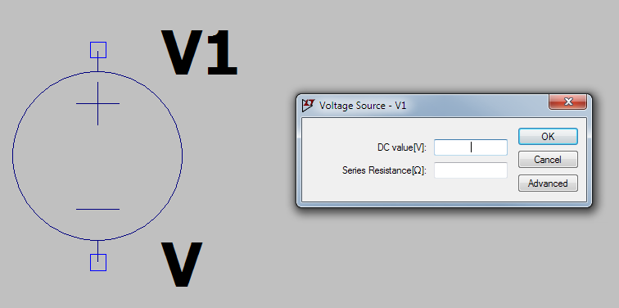
Components: Voltage Sources
Interesting Settings Under “Advanced”

Slide 7
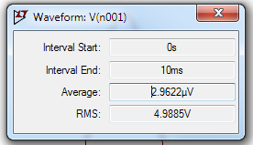
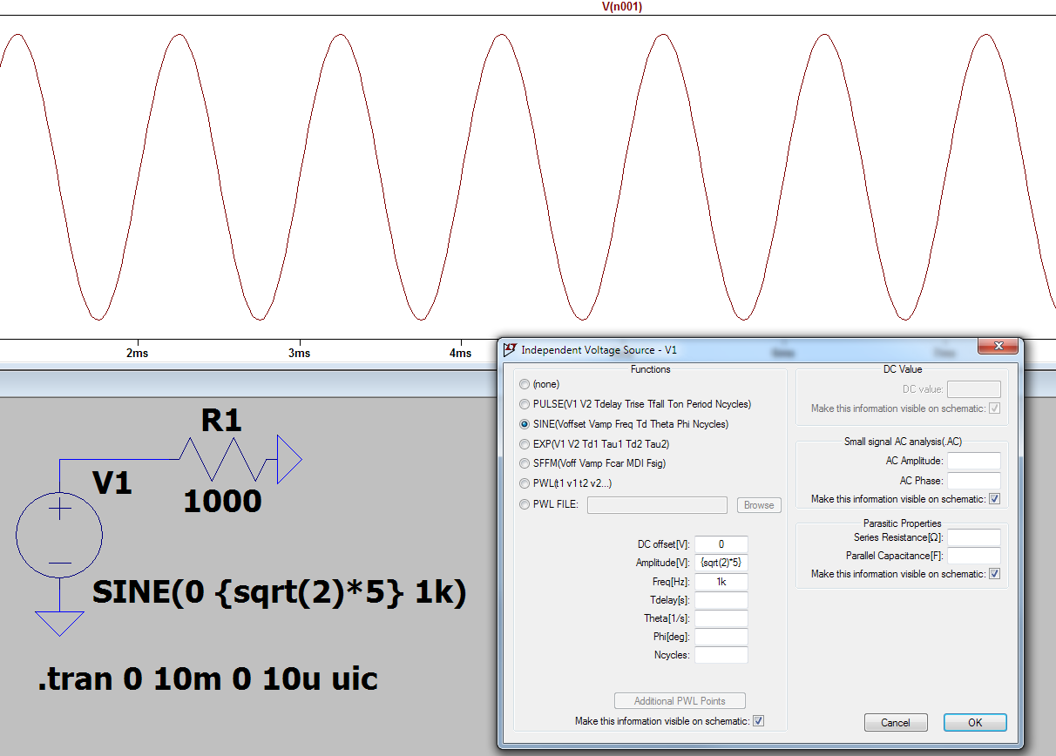
Voltage Sources: Sine Waves
(Ctrl+Click) Trace Name to show plot Average and RMS
Amplitude is PEAK Voltage
Peak Voltage = 1.414*RMS V
Use {…} to enclose expressions

Slide 8
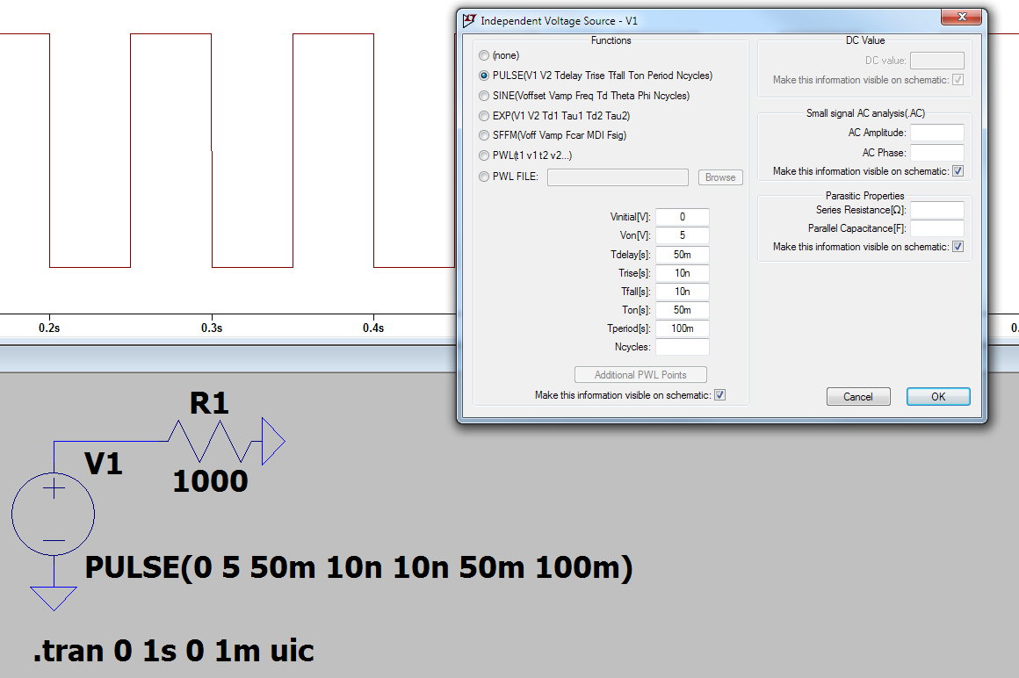
Voltage Sources: Square Wave
(Trise, Tfall) Very small, DO NOT LEAVE BLANK

Slide 9
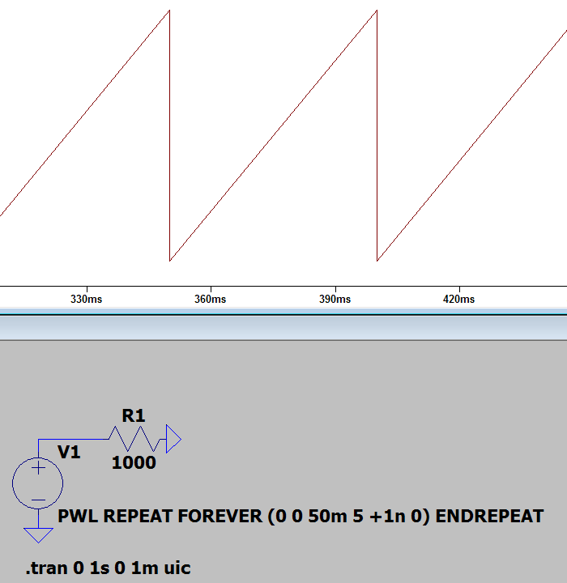
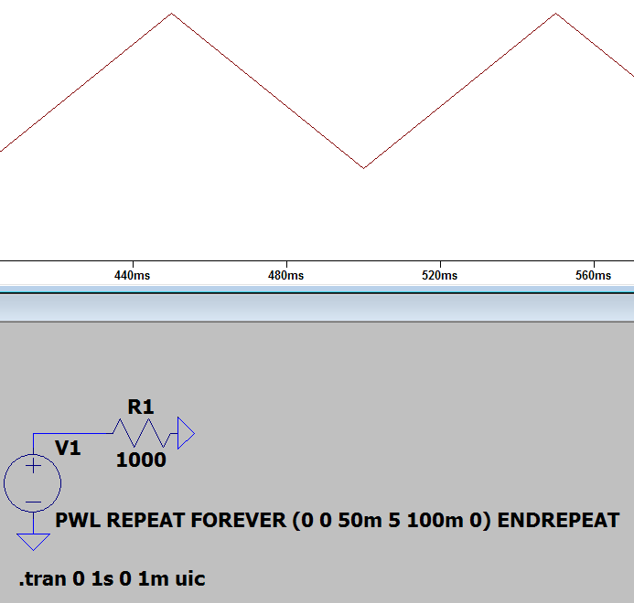
Voltage Sources: Triangular Waves
Sawtooth Wave
Triangular Wave
Start Time [s]
Start Voltage [v]
Peak Time [s]
Peak Voltage [v]
Stop Time [s]
Stop Voltage [v]
Start Time [s]
Start Voltage [v]
Peak Time [s]
Peak Voltage [v]
(1 ns After)
Stop Voltage [v]
http://www.analog.com/en/technical-articles/ltspice-generating-triangular-sawtooth-waveforms.html

Slide 10
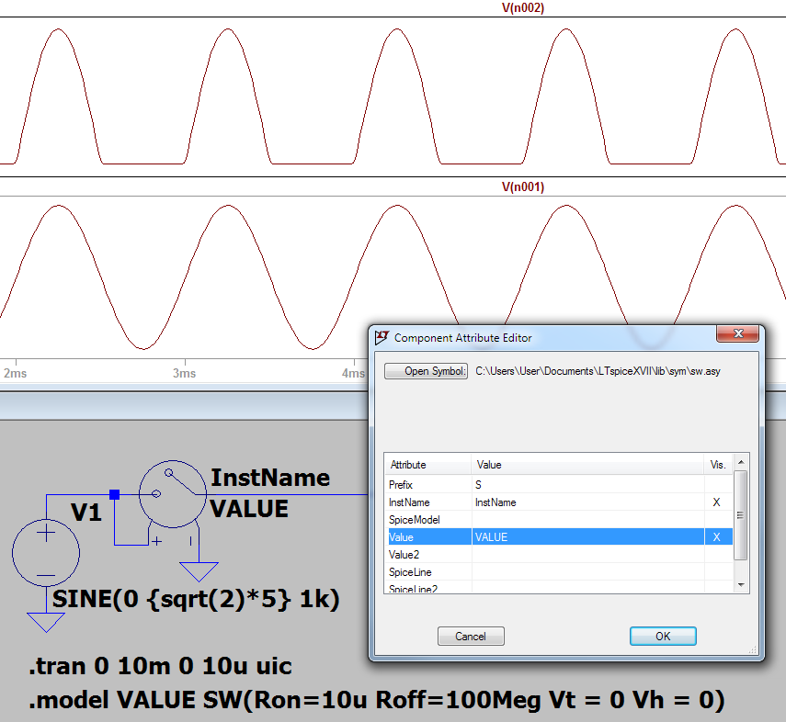
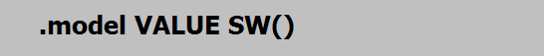
Components: Switches
Spice Directive is REQUIRED
“.model VALUE SW()”
Simplest Switch
“VALUE” is the Value (Name) of the Switch
“SW(…)” Additional Parameters:
On Resistance: “Ron=“
Off Resistance: “Roff=“
Trigger Voltage: “Vt=“
Hysteresis Voltage: “Vh=“
Component Attribute Editor
(Right-Click) the Component
http://www.analog.com/en/technical-articles/ltspiceiv-voltage-controlled-switches.html

Slide 11
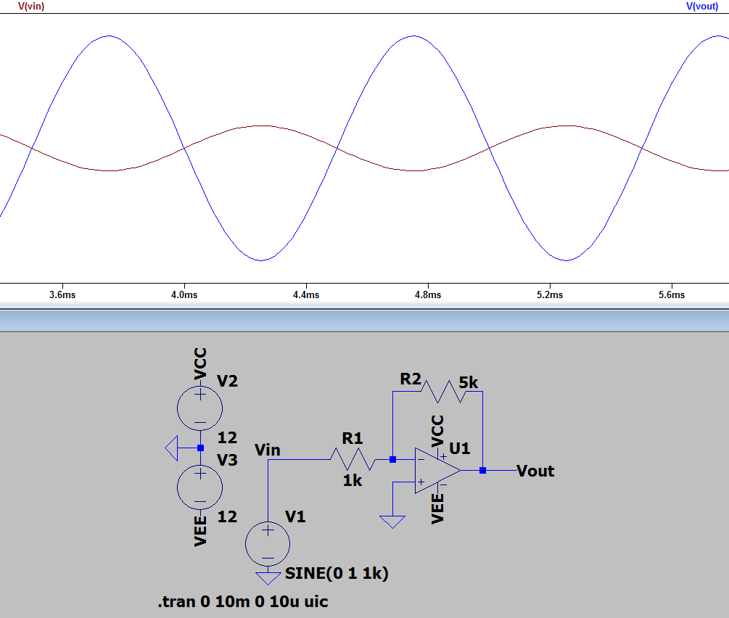
Components: Op-Amps
Net Names can be used to connect terminals without wires.
Voltage Sources can be cascaded in series. This particular arrangement is a common for +/- V.
Components > Opamps > UniversalOpamp2

Slide 12
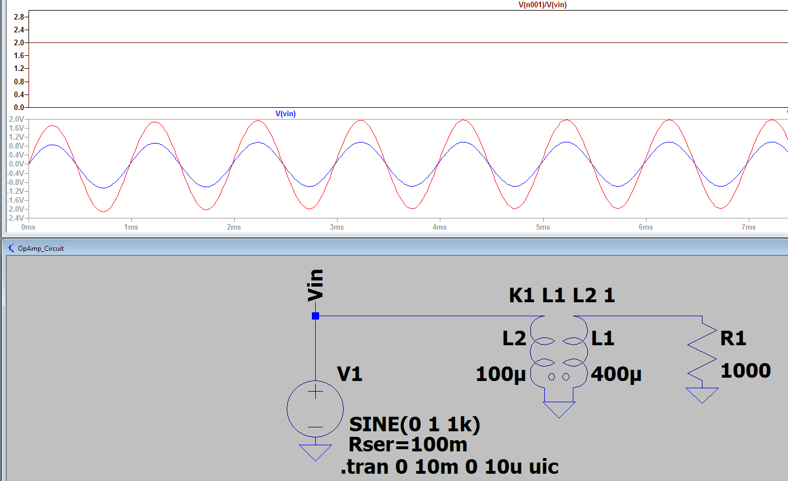

Components: Transformers
Not Great. Do NOT expect power to be conserved.
PRIMARY MUST HAVE SERIES RESISTANCE
Inductors are coupled using a spice directive
“K# L# L# Coupling”
Multiple Inductors can be mutually coupled by listing them before the coupling coefficient.
Coupling ranges from 0 (none) to 1 (complete)
$$\frac{N_{1}}{N_{2}}=\frac{V_{1}}{V_{2}}=\sqrt{\frac{L_{1}}{L_{2}}}$$
http://www.analog.com/en/technical-articles/using-transformers-in-ltspice-switcher-cadiii.html

Slide 13
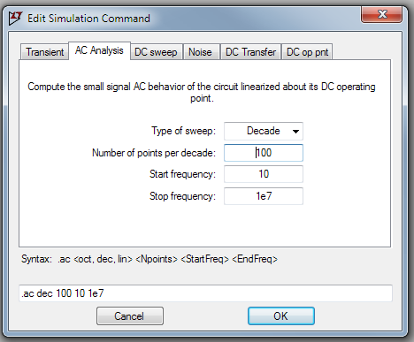
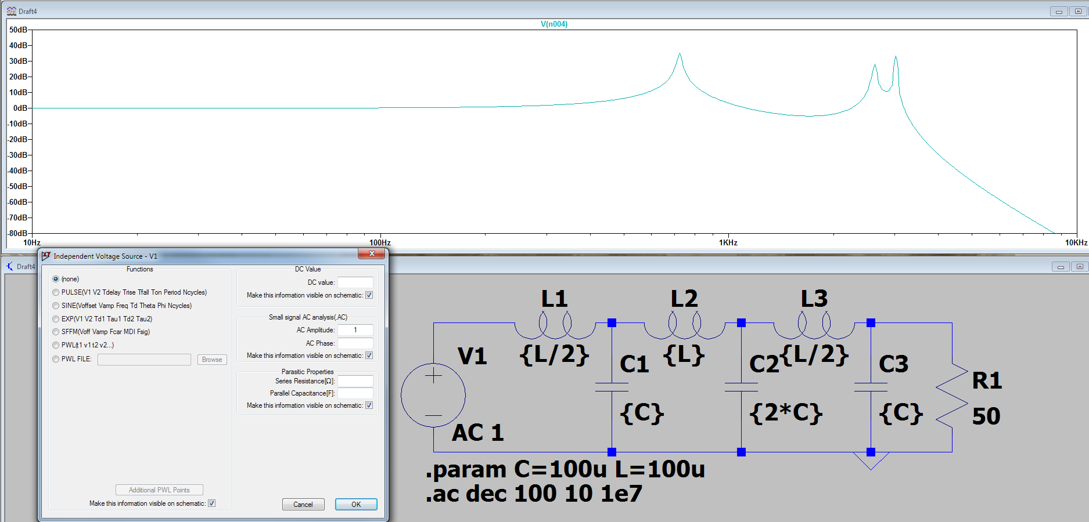
Simulation: AC Analysis
(1) Configure Simulation as “AC Analysis”
(3) Simulate
(2) Configure Source as (AC)

Slide 14
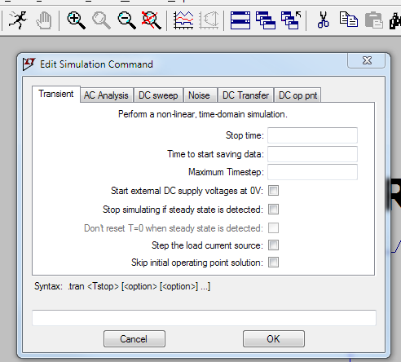
Simulation: Transient Analysis
Simulate the Presented Assuming Sources Were Just Connected
When to Stop [S]: (Keep this small)
A few periods/few time constants
Shorter will capture transients
Longer takes longer to simulate
(100’s ms) likely sufficient
Time between successive calculations
Smaller times are more accurate
Much smaller than resolution
(1 us) good to 100 kHz
(100 ns) good to 1 MHz
(10 ns) good to 10 MHz
…
Skip initial operating point solution
Translated: “Don’t guess the steady-state solution before simulating”
Highly Recommended.
(1) Click Here

Slide 15
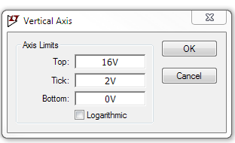
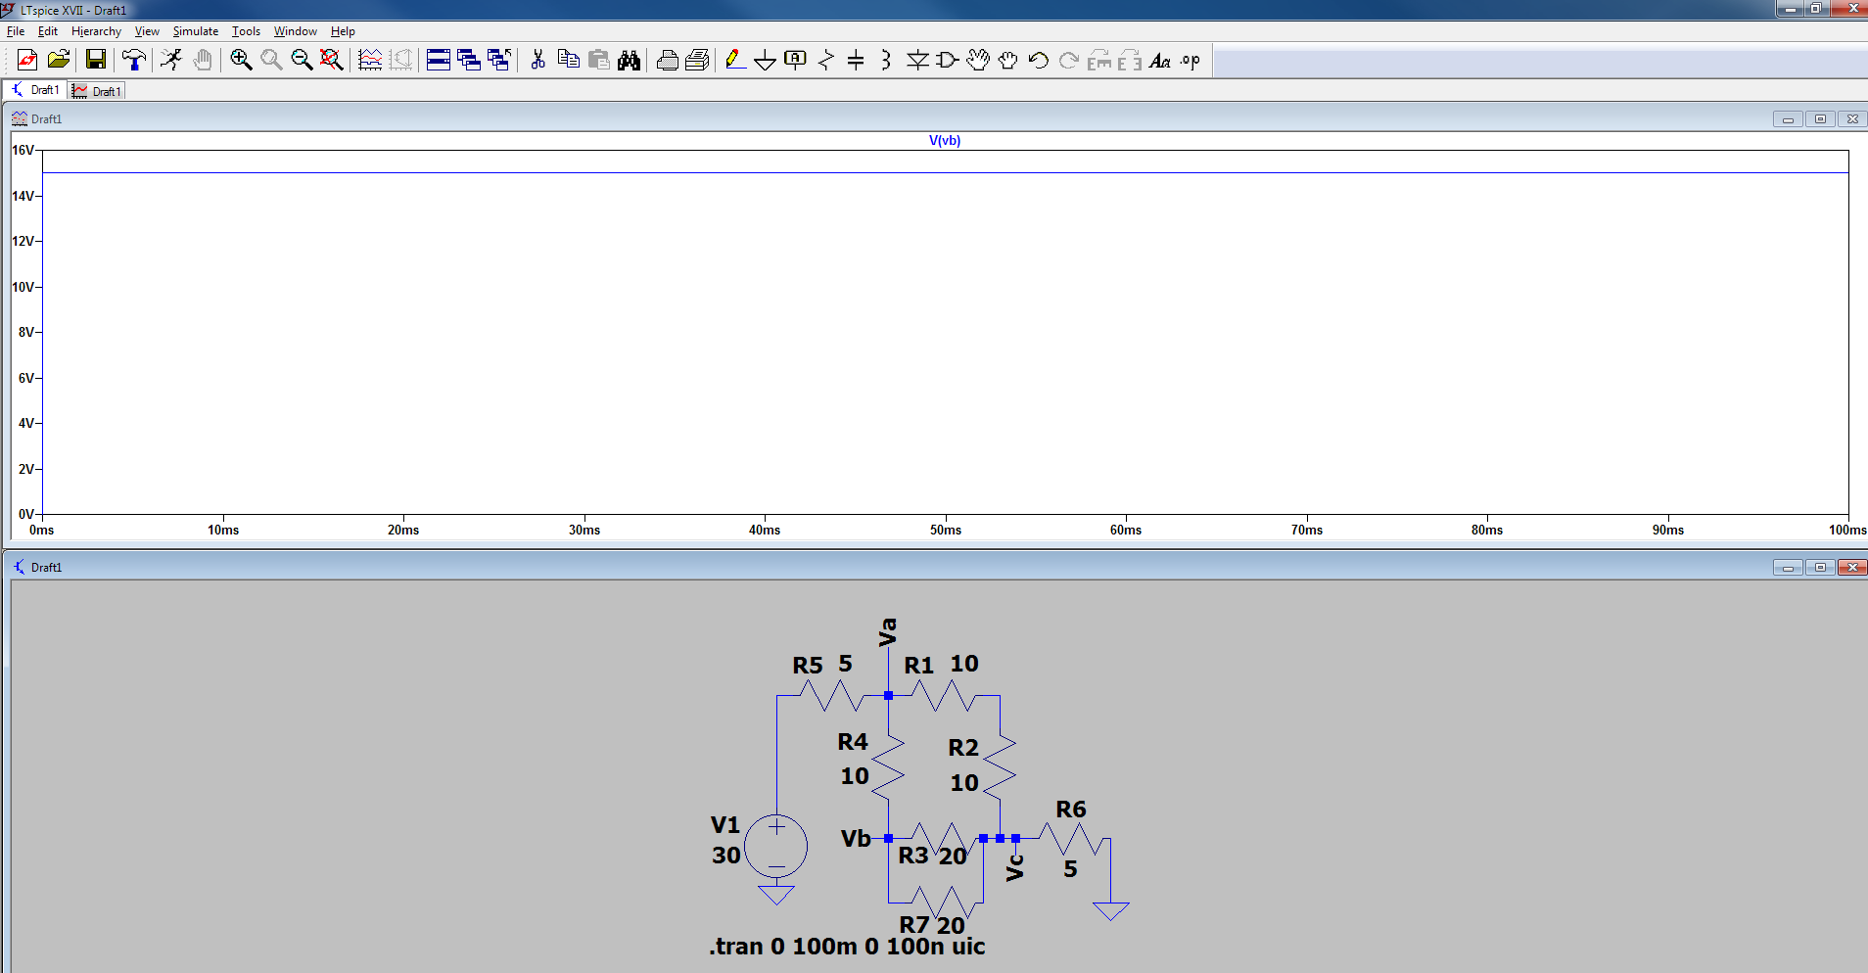
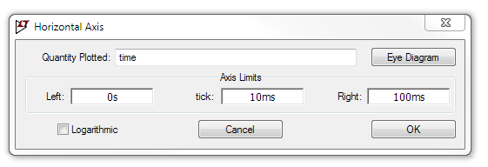
Simulation: Simple Plotting
Right-Click Axis to Manually Specify Limits
(Defaults to Auto-Fit Everything)
B: Click on Components to add Currents (Note the Current Arrow)
A: Click on Wires to add Voltages
NOTE: Double Clicking Current/Wire Clears all OTHER traces.

Slide 16
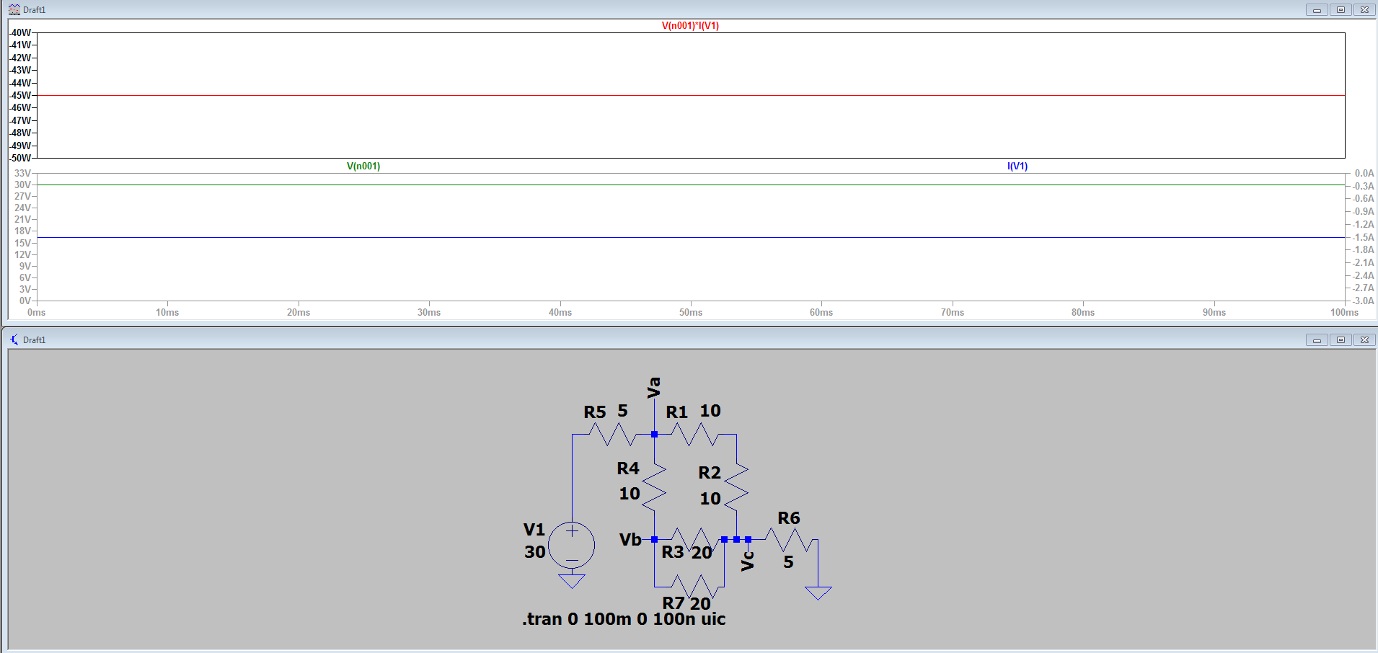
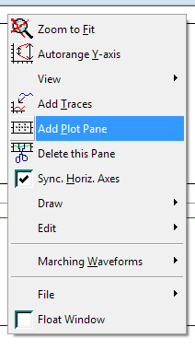
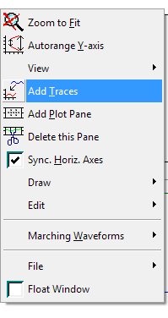
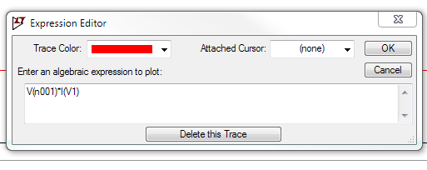
Simulation: Advanced Plotting
(Right-Click) > “Add Traces” or (Right-Click) Existing Trace NAME to open Expression Editor.
Note: (I*V) works better than (I²R)

Slide 17
Simulation: Known Issues
Discontinuities
Discontinuous functions and their derivatives tend to break the simulation.
E.g. Ideal Diodes, Perfect Switches
“.options gmin=1e-10” [1]
“.options abstol=1e-10” [1]
“.options reltol=0.003” [1]
“.options cshunt=1e-15” [1]
Magnetic Components
Shorting voltage sources into inductors
Transformers
http://www.ltwiki.org/index.php?title=Transformers
1. http://www.ltwiki.org/index.php?title=Convergence_problems%3F

Slide 18
Additional Resources
Analog Devices LTspice Download
http://www.analog.com/en/design-center/design-tools-and-calculators/ltspice-simulator.html
(Unofficial) LTspice Wiki
http://www.ltwiki.org/index.php?title=Main_Page
Great Walk Though(s)
http://denethor.wlu.ca/ltspice/#IIIE

